Slide 1
Inheritance, Polymorphism, and Interfaces
Chapter 8

Slide 2
Objectives
Describe polymorphism and inheritance in general
Define interfaces to specify methods
Describe dynamic binding
Define and use derived classes in Java
Understand how inheritance is used in the JFrame class

Slide 3
Inheritance Basics: Outline
Derived Classes
Overriding Method Definitions
Overriding Versus Overloading
The final Modifier
Private Instance Variables and Private Methods of a Base Class
UML Inheritance Diagrams

Slide 4
Inheritance Basics
Inheritance allows programmer to define a general class
Later you define a more specific class
  Adds new details to general definition
New class inherits all properties of initial, general class
View example class, listing 8.1
class Person

Slide 5
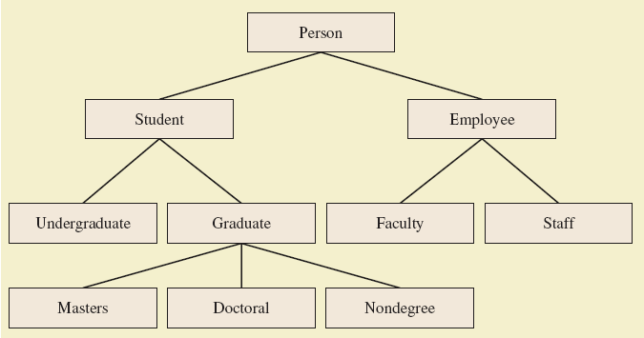
Derived Classes
Figure 8.1 A class hierarchy

Slide 6

Derived Classes
Class Person used as a base class
  Also called superclass
Now we declare derived class Student
  Also called subclass
  Inherits methods from the superclass
View derived class, listing 8.2
class Student extends Person
View demo program, listing 8.3
class InheritanceDemo
Sample
screen output

Slide 7
Overriding Method Definitions
Note method writeOutput in class Student
  Class Person also has method with that name
Method in subclass with same signature overrides method from base class
  Overriding method is the one used for objects of the derived class
Overriding method must return same type of value

Slide 8
Overriding Versus Overloading
Do not confuse overriding with overloading
  Overriding takes place in subclass – new method with same signature
Overloading
  New method in same class with different signature

Slide 9
The final Modifier
Possible to specify that a method cannot be overridden in subclass
Add modifier final to the heading
public final void specialMethod()
An entire class may be declared final
  Thus cannot be used as a base class to derive any other class

Slide 10
Private Instance Variables, Methods
Consider private instance variable in a base class
  It is not inherited in subclass
  It can be manipulated only by public accessor, modifier methods
Similarly, private methods in a superclass not inherited by subclass

Slide 11
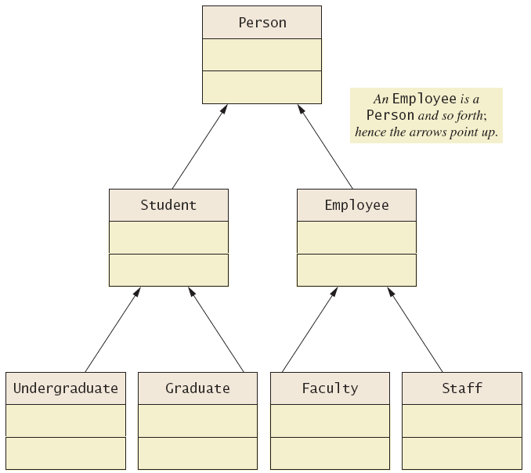
UML Inheritance Diagrams
Figure 8.2 A class
hierarchy in
UML notation

Slide 12
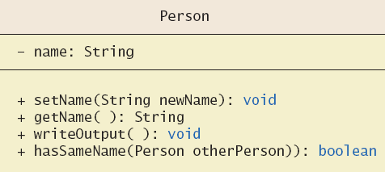
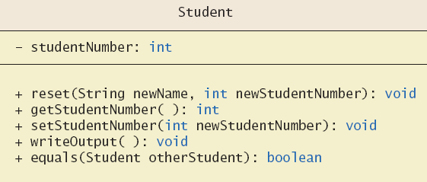
UML Inheritance Diagrams
Figure 8.3
Some details
of UML class
hierarchy
from
figure 8.2

Slide 13
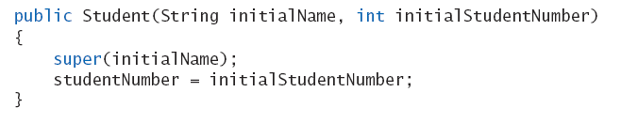
Constructors in Derived Classes
A derived class does not inherit constructors from base class
  Constructor in a subclass must invoke constructor from base class
Use the reserve word super
  Must be first action in the constructor

Slide 14

The this Method – Again
Also possible to use the this keyword
  Use to call any constructor in the class
When used in a constructor, this calls constructor in same class
  Contrast use of super which invokes constructor of base class

Slide 15
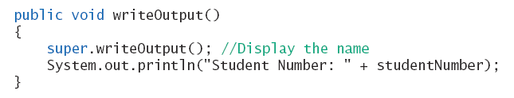
Calling an Overridden Method
Reserved word super can also be used to call method in overridden method
Calls method by same name in base class

Slide 16
Programming Example
A derived class of a derived class
View sample class, listing 8.4
class Undergraduate
Has all public members of both
  Person
  Student
This reuses the code in superclasses

Slide 17
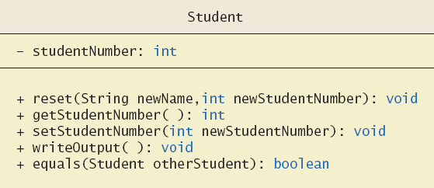
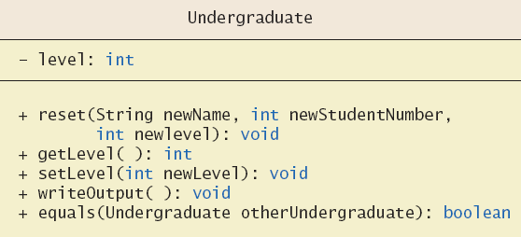
Programming Example
Figure 8.4
More details
of the UML
class
hierarchy

Slide 18
Type Compatibility
In the class hierarchy
  Each Undergraduate is also a Student
  Each Student is also a Person
An object of a derived class can serve as an object of the base class
  Note this is not typecasting
An object of a class can be referenced by a variable of an ancestor type

Slide 19
Type Compatibility
Be aware of the "is-a" relationship
  A Student is a Person
Another relationship is the "has-a"
  A class can contain (as an instance variable) an object of another type
  If we specify a date of birth variable for Person – it "has-a" Date object

Slide 20
The Class Object
Java has a class that is the ultimate ancestor of every class
  The class Object
Thus possible to write a method with parameter of type Object
  Actual parameter in the call can be object of any type
Example: method
println(Object theObject)

Slide 21
The Class Object
Class Object has some methods that every Java class inherits
Examples
  Method equals
  Method toString
Method toString called when println(theObject) invoked
  Best to define your own toString to handle this

Slide 22
A Better equals Method
Programmer of a class should override method equals from Object
View code of sample override, listing 8.8
public boolean equals
(Object theObject)

Slide 23
Polymorphism
Inheritance allows you to define a base class and derive classes from the base class
Polymorphism allows you to make changes in the method definition for the derived classes and have those changes apply to methods written in the base class

Slide 24
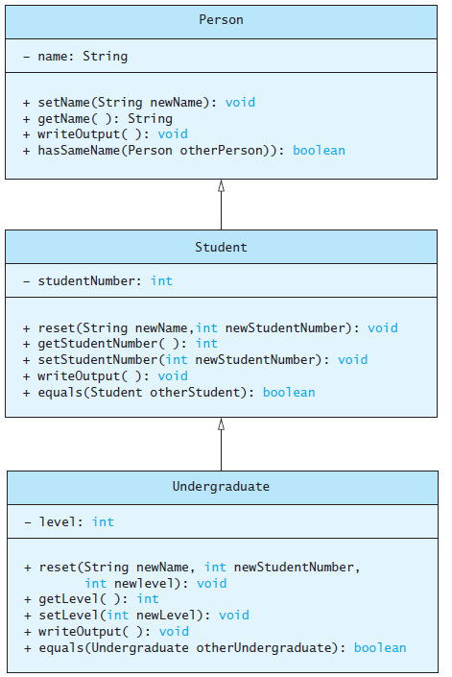
Polymorphism
Consider an array of Person
Person[] people = new Person[4];
Since Student and Undergraduate are types of Person, we can assign them to Person variables
people[0] = new Student("DeBanque, Robin", 8812);
people[1] = new Undergraduate("Cotty, Manny", 8812, 1);

Slide 25
Polymorphism
Given:
Person[] people = new Person[4];
people[0] = new Student("DeBanque, Robin", 8812);
When invoking:
people[0].writeOutput();
Which writeOutput() is invoked, the one defined for Student or the one defined for Person?
Answer: The one defined for Student

Slide 26
An Inheritance as a Type
The method can substitute one object for another
  Called polymorphism
This is made possible by mechanism
  Dynamic binding
  Also known as late binding

Slide 27
Dynamic Binding and Inheritance
When an overridden method invoked
  Action matches method defined in class used to create object using new
  Not determined by type of variable naming the object
Variable of any ancestor class can reference object of descendant class
  Object always remembers which method actions to use for each method name

Slide 28
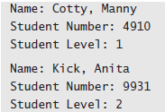
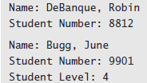
Polymorphism Example
View sample class, listing 8.6
class PolymorphismDemo
Output

Slide 29
Class Interfaces
Consider a set of behaviors for pets
  Be named
  Eat
  Respond to a command
We could specify method headings for these behaviors
These method headings can form a class interface

Slide 30
Class Interfaces
Now consider different classes that implement this interface
  They will each have the same behaviors
  Nature of the behaviors will be different
Each of the classes implements the behaviors/methods differently

Slide 31
Java Interfaces
A program component that contains headings for a number of public methods
  Will include comments that describe the methods
Interface can also define public named constants
View example interface, listing 8.7
interface Measurable

Slide 32
Java Interfaces
Interface name begins with uppercase letter
Stored in a file with suffix .java
Interface does not include
  Declarations of constructors
  Instance variables
  Method bodies

Slide 33
Implementing an Interface
To implement a method, a class must
  Include the phrase
  implements Interface_name
  Define each specified method
View sample class, listing 8.8
class Rectangle implements Measurable
View another class, listing 8.9 which also implements Measurable
class Circle

Slide 34
An Inheritance as a Type
Possible to write a method that has a parameter as an interface type
  An interface is a reference type
Program invokes the method passing it an object of any class which implements that interface

Slide 35
Extending an Interface
Possible to define a new interface which builds on an existing interface
  It is said to extend the existing interface
A class that implements the new interface must implement all the methods of both interfaces

Slide 36
Case Study
Character Graphics
View interface for simple shapes,
listing 8.10 interface ShapeInterface
If we wish to create classes that draw rectangles and triangles
  We could create interfaces that extend ShapeInterface
  View interfaces, listing 8.11

Slide 37
Case Study
Now view base class, listing 8.12 which uses (implements) previous interfaces
class ShapeBasics
Note
  Method drawAt calls drawHere
  Derived classes must override drawHere
  Modifier extends comes before implements

Slide 38
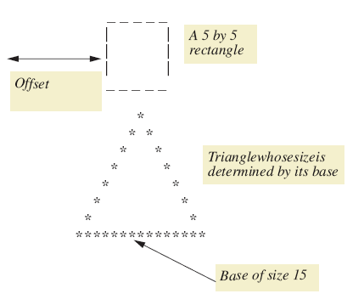
Case Study
Figure 8.5 A sample rectangle and triangle

Slide 39
Case Study
Note algorithm used by method drawHere to draw a rectangle
  Draw the top line
  Draw the side lines
  Draw the bottom lines
Subtasks of drawHere are realized as private methods
View class definition, listing 8.13
class Rectangle

Slide 40
Case Study
View next class to be defined (and tested),
listing 8.14 class Triangle
It is a good practice to test the classes as we go
View demo program, listing 8.15
class TreeDemo

Slide 41
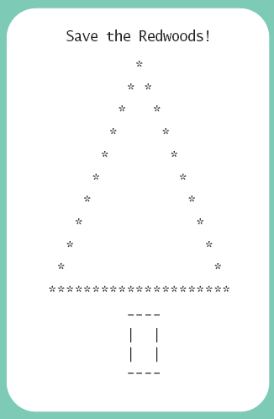
Case Study
Sample
screen output

Slide 42
Case Study
The Comparable Interface
Java has many predefined interfaces
One of them, the Comparable interface, is used to impose an ordering upon the objects that implement it
Requires that the method compareTo be written
public int compareTo(Object other);

Slide 43
Sorting an Array of Fruit Objects
Initial (non-working) attempt to sort an array of Fruit objects
View class definition, listing 8.16
class Fruit
View test class, listing 8.17
class FruitDemo
Result: Exception in thread “main”
  Sort tries to invoke compareTo method but it doesn’t exist

Slide 44
Sorting an Array of Fruit Objects
Working attempt to sort an array of Fruit objects – implement Comparable, write compareTo method
View class definition, listing 8.18
class Fruit
Result: Exception in thread “main”
  Sort tries to invoke method but it doesn’t exist

Slide 45
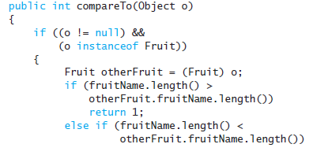
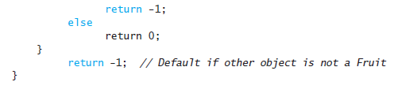
compareTo Method
An alternate definition that will sort by length of the fruit name

Slide 46
Abstract Classes
Class ShapeBasics is designed to be a base class for other classes
  Method drawHere will be redefined for each subclass
  It should be declared abstract – a method that has no body
This makes the class abstract
You cannot create an object of an abstract class – thus its role as base class

Slide 47
Abstract Classes
Not all methods of an abstract class are abstract methods
Abstract class makes it easier to define a base class
  Specifies the obligation of designer to override the abstract methods for each subclass

Slide 48
Abstract Classes
Cannot have an instance of an abstract class
  But OK to have a parameter of that type
View abstract version, listing 8.19
abstract class ShapeBase

Slide 49
Dynamic Binding and Inheritance
Note how drawAt (in ShapeBasics) makes a call to drawHere
Class Rectangle overrides method drawHere
  How does drawAt know where to find the correct drawHere?
Happens with dynamic or late binding
  Address of correct code to be executed determined at run time

Slide 50
Graphics Supplement: Outline
The Class JApplet
The Class JFrame
Window Events and Window Listeners
The ActionListener Interface

Slide 51
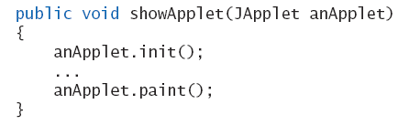
The Class JApplet
Class JApplet is base class for all applets
  Has methods init and paint
When you extend JApplet you override (redefine) these methods
Parameter shown
will use your
versions due to
polymorphism

Slide 52
The Class JFrame
For GUIs to run as applications (instead of from a web page)
  Use class JFrame as the base class
View example program, listing 8.20
class ButtonDemo
Note method setSize
  Width and height given in number of pixels
  Sets size of window

Slide 53
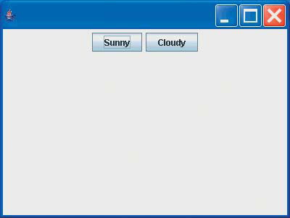
The Class JFrame
View demo program, listing 8.21
class ShowButtonDemo
Sample
screen output

Slide 54
Window Events and Window Listeners
Close-window button
fires an event
  Generates a window event handled by a window listener
View class for window events,
listing 8.22, class WindowDestroyer
Be careful not to confuse JButtons and the close-window button

Slide 55
The ActionListener Interface
Use of interface ActionListener requires only one method
public void actionPerformed
(ActionEvent e)
Listener that responds to button clicks
  Must be an action listener
  Thus must implement ActionListener interface

Slide 56
Summary
An interface contains
  Headings of public methods
  Definitions of named constants
  No constructors, no private instance variables
Class which implements an interface must
  Define a body for every interface method specified
Interface enables designer to specify methods for another programmer

Slide 57
Summary
Interface is a reference type
  Can be used as variable or parameter type
Interface can be extended to create another interface
Dynamic (late) binding enables objects of different classes to substitute for one another
  Must have identical interfaces
  Called polymorphism

Slide 58
Summary
Derived class obtained from base class by adding instance variables and methods
  Derived class inherits all public elements of base class
Constructor of derived class must first call a constructor of base class
  If not explicitly called, Java automatically calls default constructor

Slide 59
Summary
Within constructor
  this calls constructor of same class
  super invokes constructor of base class
Method from base class can be overridden
  Must have same signature
If signature is different, method is overloaded

Slide 60
Summary
Overridden method can be called with preface of super
Private elements of base class cannot be accessed directly by name in derived class
Object of derived class has type of both base and derived classes
Legal to assign object of derived class to variable of any ancestor type

Slide 61
Summary
Every class is descendant of class Object
Class derived from JFrame produces applet like window in application program
Method setSize resizes JFrame window
Class derived from WindowAdapter defined to be able to respond to closeWindow button

